Slide 1
Software for Uncertainty Quantification (MS91)
8:35-9:00 - OpenTURNS for Uncertainty Quantification
Michael Baudin, Anne Dutfoy, Anne-Laure Popelin, EDF, France
9:05-9:30 - Promethee Environment for Computer Code Inversion
Yann Richet, Gregory Caplin, IRSN, France
9:35-10:00 - ‘Mystic’: Highly constrained Non-convex Optimization and Uncertainty Quantification
Michael McKerns, California Institute of Technology, USA
10:05-10:30 - Uranie: the Uncertainty and Optimization Platform
Fabrice Gaudier, Jean-Marc Martinez, Gilles Arnaud, CEA, France
Notes:
Good morning and welcome to this session on softwares for UQ.
Thank you to attend and thanks to the speakers.
I am ALP, together with my colleagues MBN and ADY (who could not attend the conference).
We work for French Electricity Supplier EDF, in a research & development department on Industrial Risk Management challenges.

Slide 2
OpenTURNS for Uncertainty Quantification
Thursday, April 7
MS91 : Software for Uncertainty Quantification
SIAM Conference on Uncertainty Quantification
Michael Baudin, Anne Dutfoy, Anne-Laure Popelin
Industrial Risk Management, EDF R&D, Chatou, France
michael.baudin@edf.fr, anne.dutfoy@edf.fr, anne-laure.popelin@edf.fr
Notes:
We work in a risk management department, in support of different engineering branches.

Slide 3
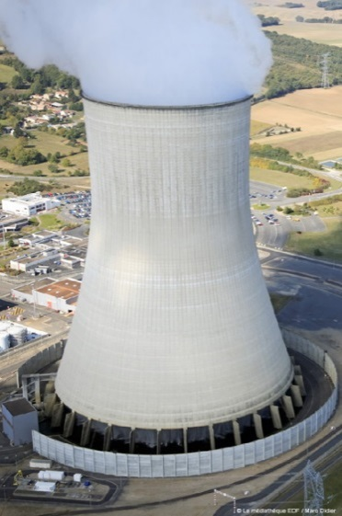
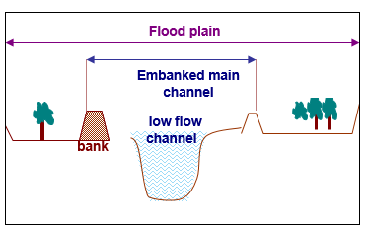
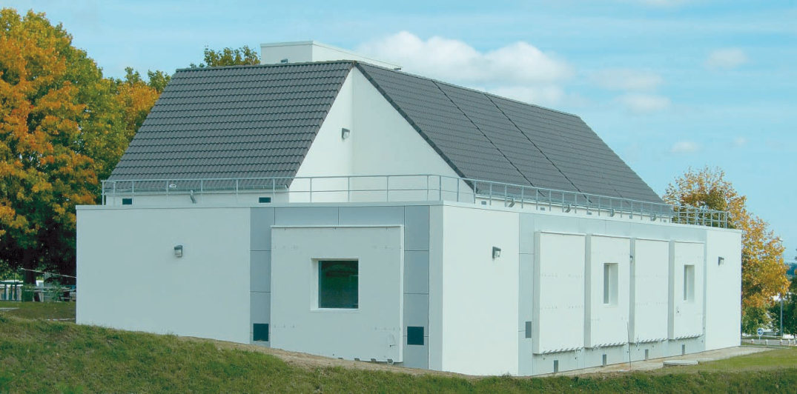
Some EDF applications
Safety and reliability of structures :
Margins assessment
Safety compliance
Calibration/validation
quality of our studies
validity domain of numerical codes (« VVUQ »)
Robust Optimization
Performance of new systems
Optimization of maintenance policy
Cooling tower, Civaux (Vienne)
Inverse calibration of Strickler coefficient in a flood model
Optimization of buildings’ energy performance
Notes:
Our applications mainly deal with safety and lifetime issues, especially in the nuclear context.
We also evaluate and optimize the performance of new energy technologies, for example renewable energies.

Slide 4
Outline
Global framework of uncertainty treatment
OpenTURNS overview
A simple exercise
External modules
New features and perspectives
Optimized LHS
EGO
GUI
Visualization in uncertainty study

Slide 5
Outline
Global framework of uncertainty treatment
OpenTURNS overview
A simple exercise
External modules
New features and perspectives
Optimized LHS
EGO
GUI
Visualization in uncertainty study

Slide 6
Uncertainty methodology
OpenTURNS uses the « Global Methodology of Treatment of Uncertainties » :
Step A : Study specification : uncertain input variables, model, variable of interest, quantity of interest (e.g. central dispersion)
Step B : Uncertainty quantification : defines the joint distribution of the input (e.g. μ in the Normal distr.)
Step C : Uncertainty propagation : estimates the quantity of interest (e.g. the mean)
Step C’ : Sensitivity analysis : ranks the input variables from the variable with highest impact to the lowest

Slide 7
Outline
Global framework of uncertainty treatment
OpenTURNS overview
A simple exercise
External modules
New features and perspectives
Optimized LHS
EGO
GUI
Visualization in uncertainty study

Slide 8




OpenTURNS : www.openturns.org
Features
Steps : A, B, C, C’
Stochastic processes
Meta-models : polynomial chaos, kriging, support vector machine
Sensitivity analysis : Morris, Sobol’
Threshold probability : FORM/SORM, Subset Sampling, Adaptive Directional Sampling
Computer code G :
Multi-thread evaluation of an analytical formula (exact derivatives)
Distributed and multi-thread evaluation of a Python function (with finite differences)
Evaluation by SALOME
Context :
Since 2005
Four partners :
Documentation : for Python users, for developers
Programing interface : Python module, C++ library
Licence : LGPL
Linux, Windows
1 technical committee / month
1 board committee / month

Slide 9
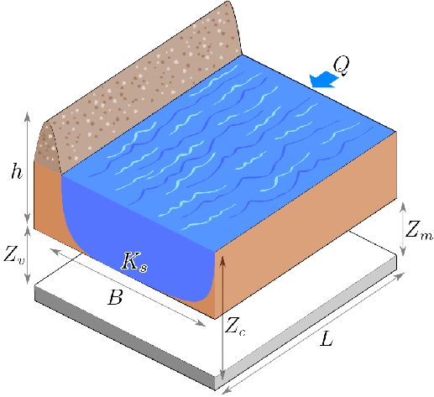

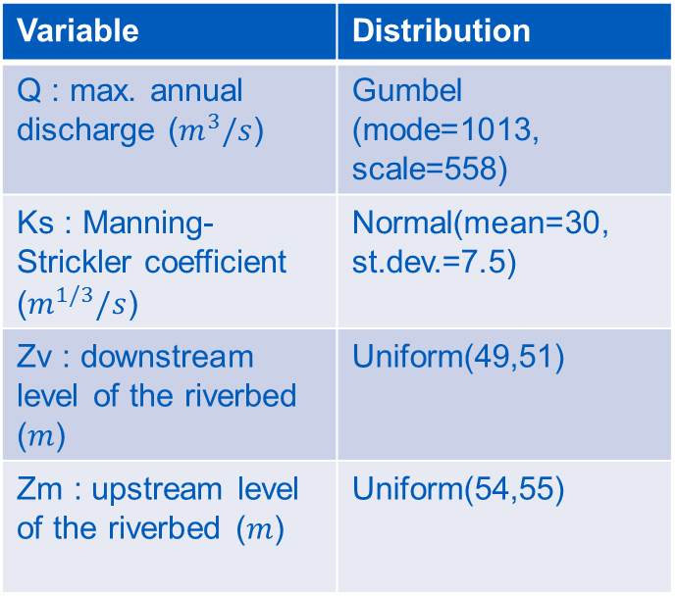
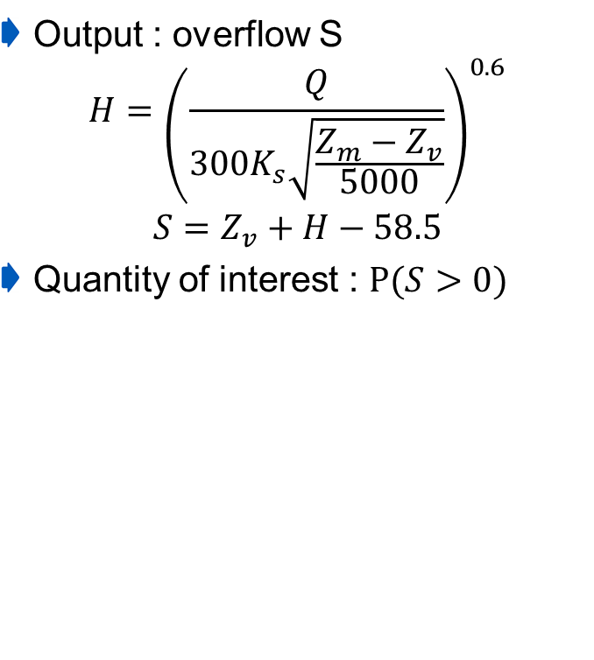
OpenTURNS : a simple exercise
Open TURNS – Trainings
Output : overflow S
$$H={\left(\frac{Q}{300K_{s}\sqrt{\frac{Z_{m}−Z_{v}}{5000}}}\right)}^{0.6}$$
$$S=Z_{v}+H−58.5$$
Quantity of interest : $P(S>0)$
Four independent input variables
Variable | Distribution
Q : max. annual discharge ($m^{3}/s$) | Gumbel (mode=1013, scale=558)
Ks : Manning-Strickler coefficient ($m^{1/3}/s$) | Normal(mean=30, st.dev.=7.5)
Zv : downstream level of the riverbed ($m$) | Uniform(49,51)
Zm : upstream level of the riverbed ($m$) | Uniform(54,55)
Notes:
9

Slide 10
OpenTURNS : a simple exercise in Python
Open TURNS – Trainings
Here is a simple exercise in Python, which is used in the OpenTURNS training.
We first import the openturns module.
from openturns import *
We then define the G Python function which takes the input X as argument and returns the output S.
# 1. Define G
def functionCrue(X) :
Q, Ks, Zv, Zm = X
alpha = (Zm - Zv)/5.0e3
H = (Q/(300.0*Ks*sqrt(alpha)))**0.6
S = [H + Zv - 58.5]
return S
We finally use the PythonFunction class which converts the Python function into a function callable by OpenTURNS.
myWrapper = PythonFunction(4,1,functionCrue)
The next step is to define each input variable and its marginal distribution.
# 2. Define input variables
Q = Gumbel(1./558., 1013.)
Q = TruncatedDistribution(Q, 0, inf)
Ks = Normal(30.0, 7.5)
Ks = TruncatedDistribution(Ks, 0, inf)
Zv = Uniform(49.0, 51.0)
Zm = Uniform(54.0, 56.0)
We create the input random vector by combining the marginal distributions with an independent copula and create the output random vector.
# 3. Create the output Y=G(X)
inputX = ComposedDistribution([Q, Ks, Zv, Zm])
inputvector = RandomVector(inputX)
outputvector = RandomVector(myWrapper, inputvector)
Notes:
10

Slide 11
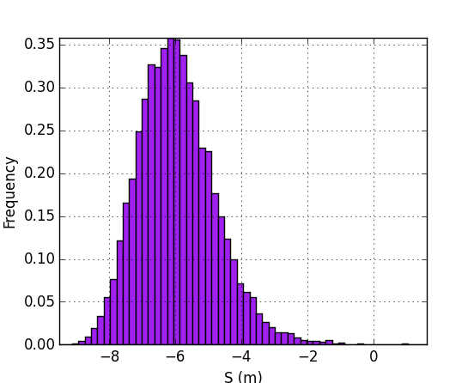
OpenTURNS : a simple exercise in Python
Open TURNS – Trainings
We define the event by combining the output random vector with the zero threshold and a comparison operator.
# 4. Estimate the probability
eventF = Event(outputvector, GreaterOrEqual(), 0)
We use a simple Monte-Carlo estimate.
algoProb = MonteCarlo(eventF)
algoProb.setMaximumOuterSampling(1000000)
algoProb.setMaximumCoefficientOfVariation(0.1)
algoProb.run()
resultAlgo = algoProb.getResult()
neval = myWrapper.getEvaluationCallsNumber()
pf = resultAlgo.getProbabilityEstimate()
In the Python console :
Number of function calls = 153501
Failure Probability = 6.514616e-04
Notes:
11

Slide 12

OpenTURNS : modularity
PMML : xml files for metamodel exchange
Optimized LHS
Mixmod : supervised & unsupervised classification
Subset method for rare event estimation
How to contribute to OpenTURNS?
doc.openturns.org/sphinx/contribute
Report bugs on the bugtracker
Suggest a new feature on github
Your developpment can be included in the core or as a module
FFTW : Fast Fourier Transform
OpenTURNS
Stratified Directionnal Adaptative (rare event)
Agrum : Bayesian Networks
SVM classification

Slide 13
Outline
Global framework of uncertainty treatment
OpenTURNS overview
A simple exercise
External modules
New features and perspectives
Optimized LHS
EGO
GUI
Visualization in uncertainty study

Slide 14
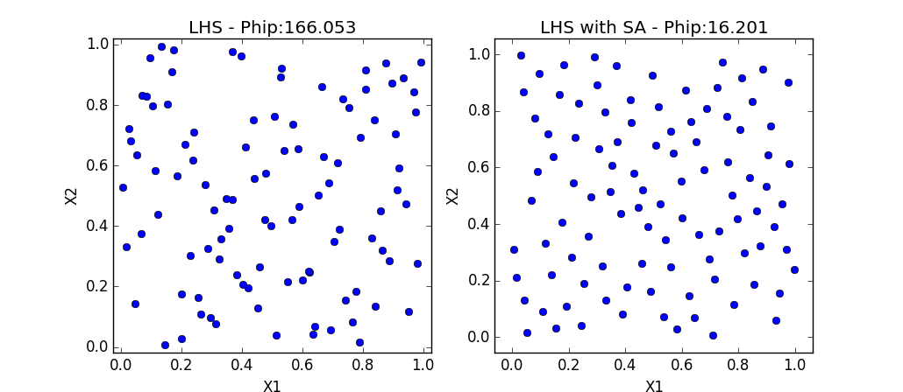
The Optimized LHS module
Goal
Create space-filling, optimized Latin Hypercube Sampling designs
Algorithm :
Several space-fillling criteria : mindist or phi-p
Optimization by simulated annealing (or Monte-Carlo)
Two LHS with 100 points left : classical, right : optimized with simulated annealing

Slide 15
Ongoing work : Efficient Global Optimization (EGO)
Objectives
Optimize a nonlinear, blackbox, costly objective function.
Get a global optimum by exploring the whole input space.
Use a kriging meta-model.
Algorithm
Create an initial design of experiment D (e.g. optimized LHS)
Evaluate the G function on the design
Create the kriging meta-model
Loop over the iterations :
Find a new point X minimizing the expected improvement
Add this point to the design D, evaluate Y=G(X)
Update the kriging meta-model
Output : the best point X so far

Slide 16
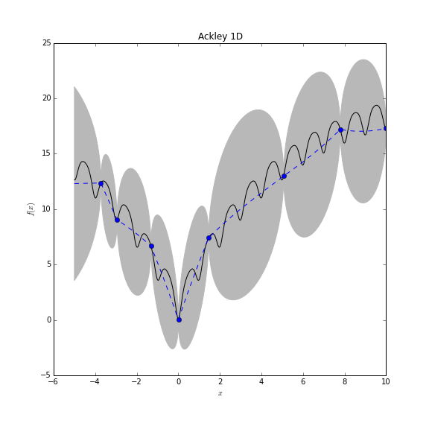
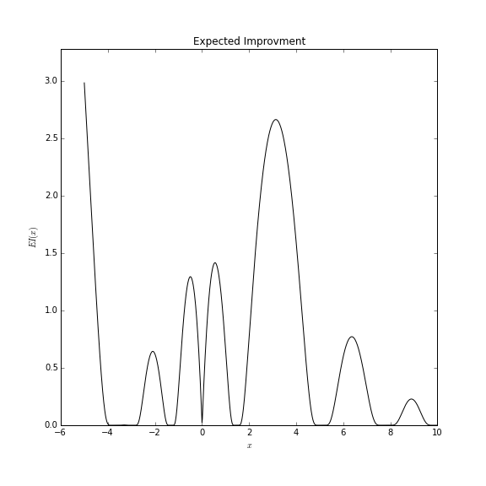
Efficient Global Optimization (EGO)

Slide 17
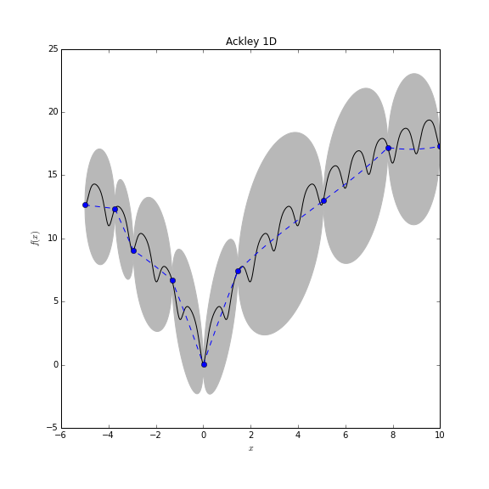
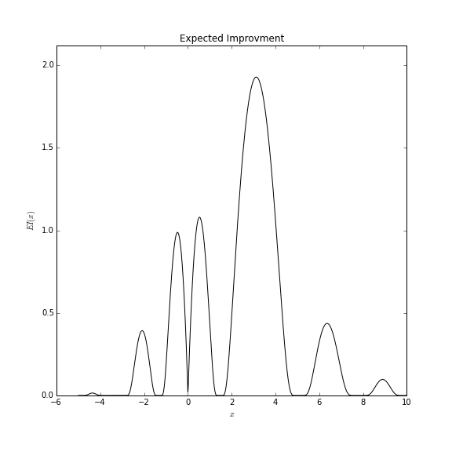
Efficient Global Optimization (EGO)

Slide 18
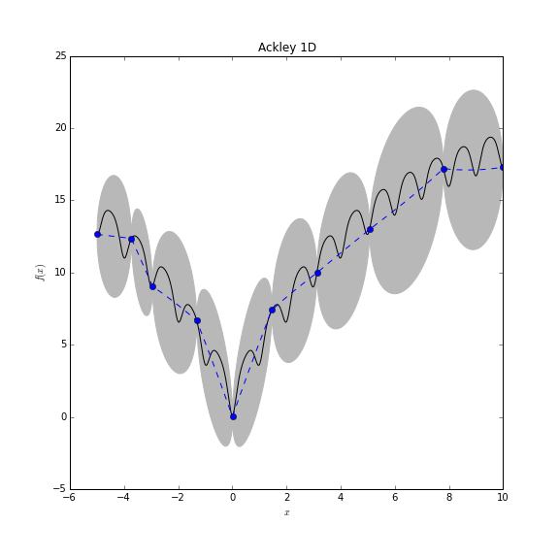
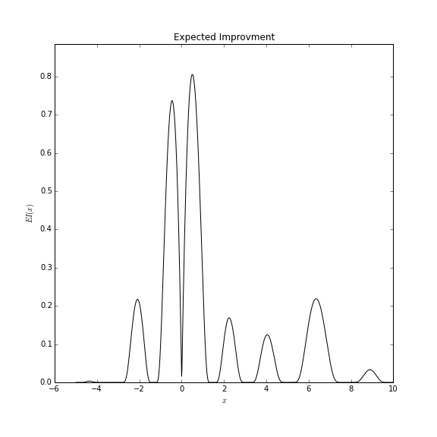
Efficient Global Optimization (EGO)

Slide 19
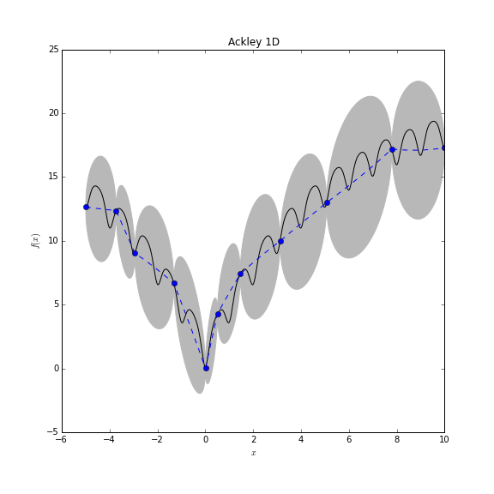
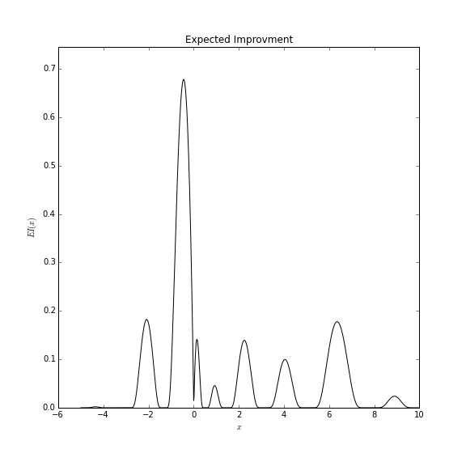
Efficient Global Optimization (EGO)
In OpenTURNS v1.8 (summer 2016)

Slide 20
OpenTURNS Graphical User Interface
GUI features
Generic (not dedicated to a specific application)
Access to the main functions of A, B, C, C’ steps
Schedule :
Release : Summer 2016
Then : one release each year
Development : with our partner Phimeca (50% / 50%)
Licence : LGPL
Notes:
To improve the dissemination / spread of the uncertainty approches towards the engineering departments : importance of the user-friendliness, especially for non-Python specialists
To ensure the autonomy of the users on at least the most classical or basic methods
Integrated to the classical study workflow (Salome as our favorite pre- and post-processing environment – allows to couple simulation codes, to use HPC clusters, …)
integration in SALOME (Automn)

Slide 21
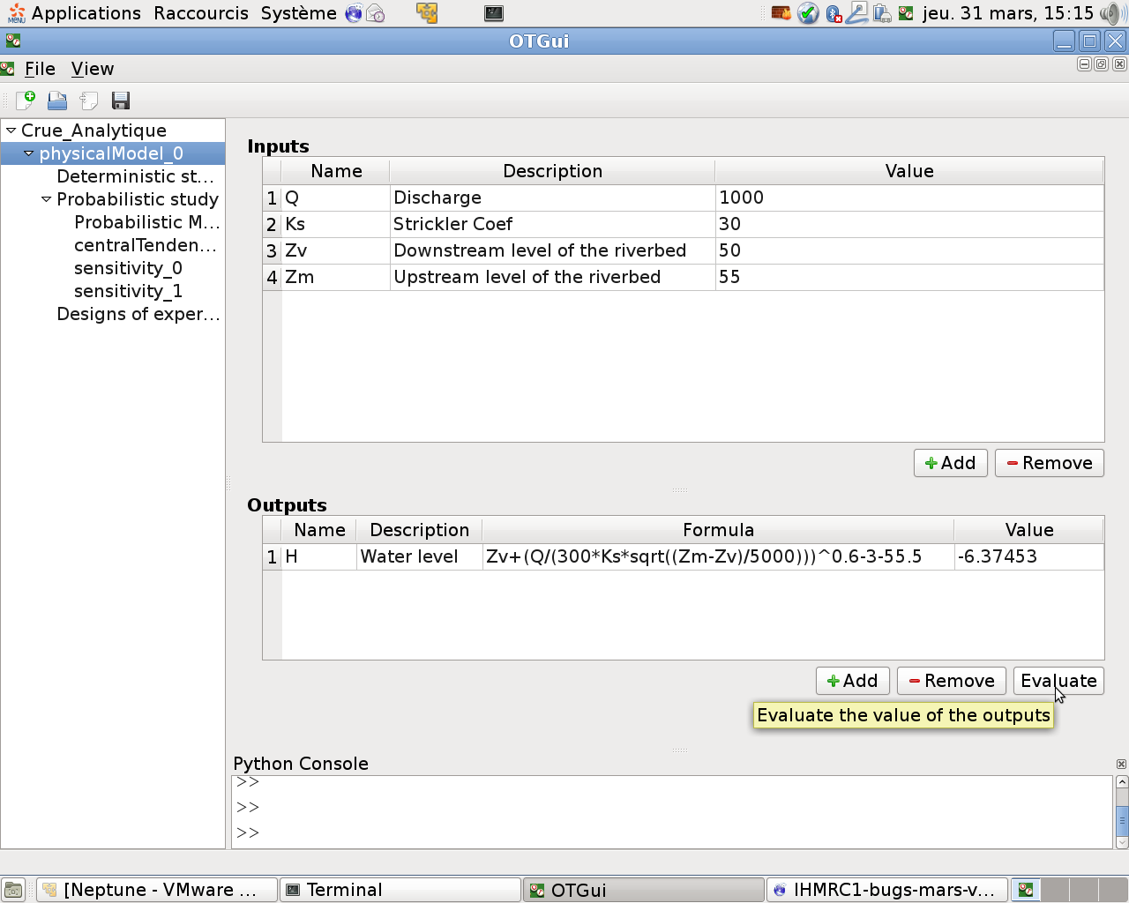
OpenTURNS Graphical User Interface
Definition of the physical model
Can be :
An analytical formula
A Python Function
An external model given in a dedicated xml file
Notes:
Screen shot of the window for definition of the physical model

Slide 22
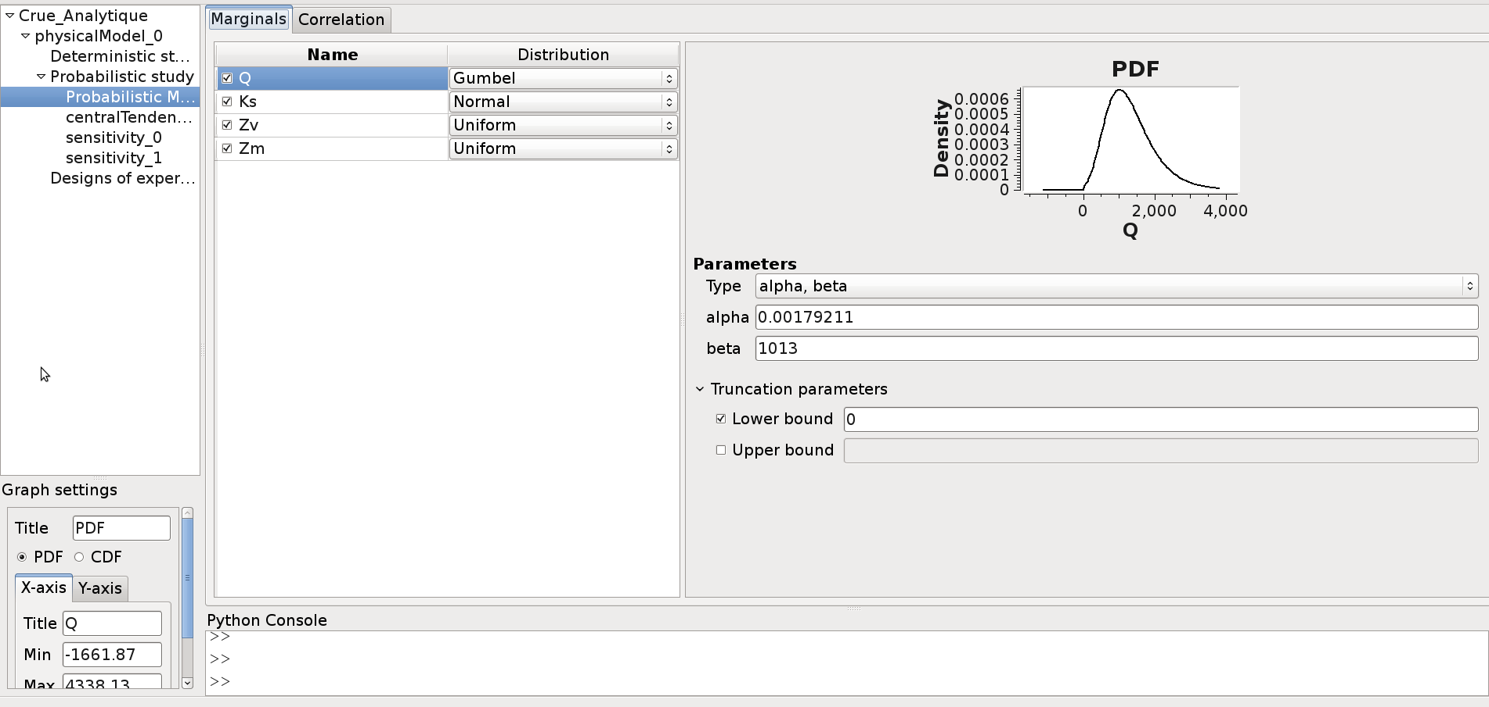
OpenTURNS Graphical User Interface
Uncertainty Quantification step : Define the joint distribution :
- marginals and their parameters
- correlation (Gaussian copula in the GUI)
Notes:
Different set of parameters depending on the distribution

Slide 23
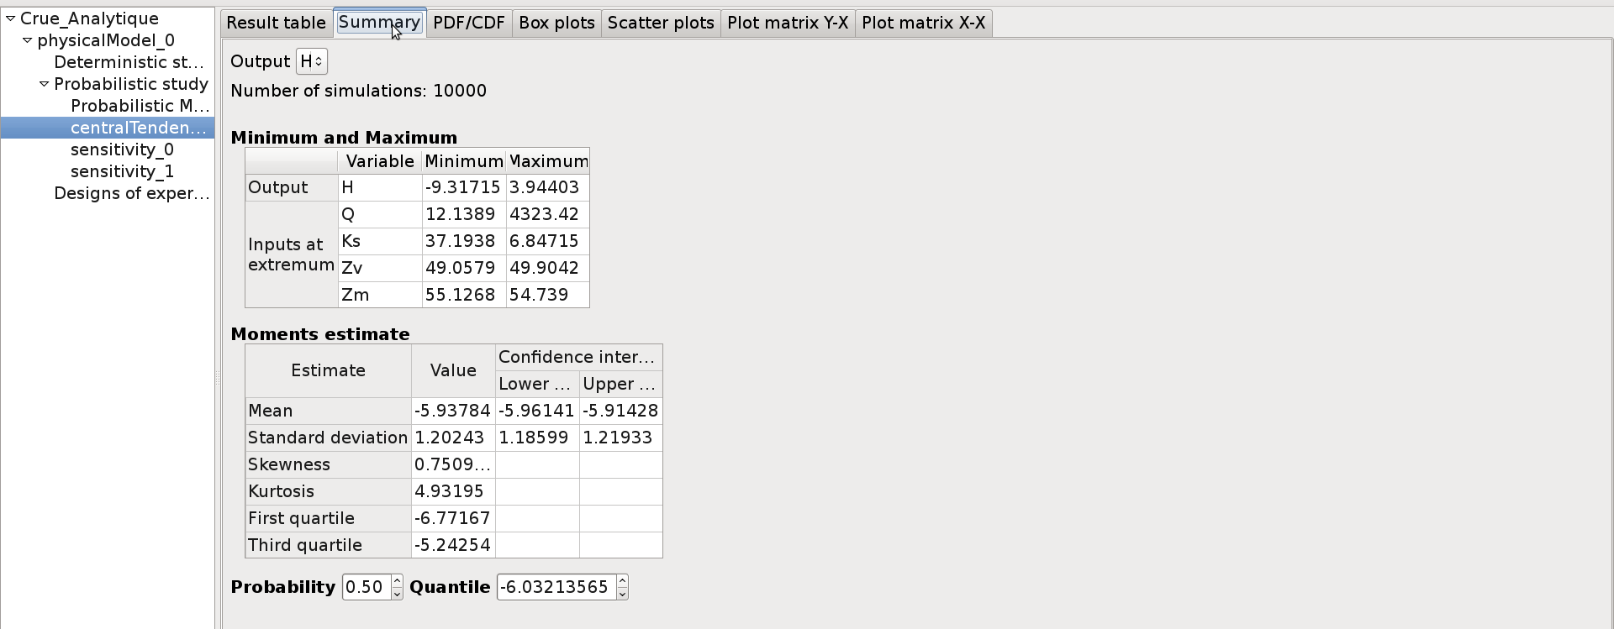
OpenTURNS Graphical User Interface
Uncertainty propagation results : central dispersion (by Monte Carlo Sampling here)
- analysis of the summary statistics
- other tabs : graphical results

Slide 24
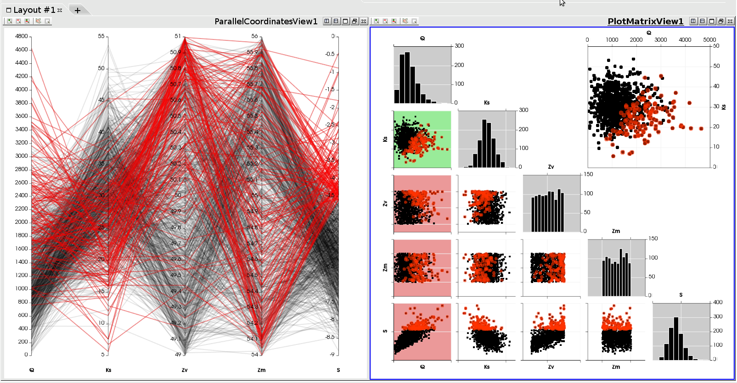



OpenTURNS Graphical User Interface
For the v2 : data visualization with dedicated tool « Paraview »
Notes:
For data analysis it is highly important to access to interactive visualization tools : our GUI will provide such graphics thanks to an integration of Paraview widgets.
The two graphics are linked : selection of points on one, highlights the same sub-sample on the other view.

Slide 25
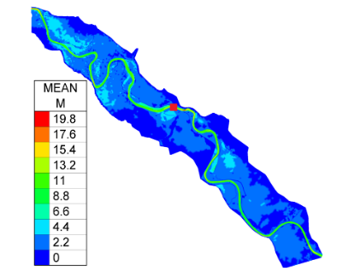
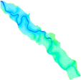
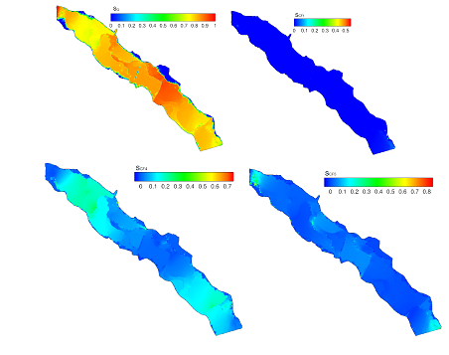
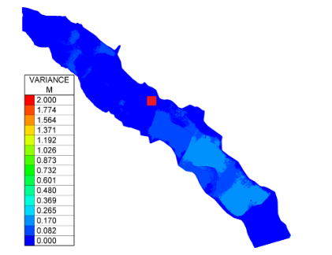
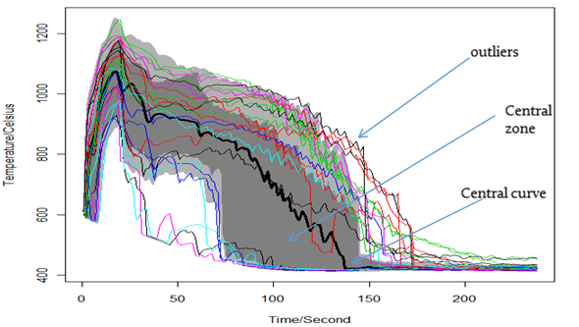
Visualization : next steps
See also : Wednesday, April 6 - MS61 : Visualization in Computer Experiments
Fields :
Functionnal (2D or 3D) boxplot:
Water level 1
Water level 2
Post-processing
Water level N=70000
Sensitivity Analysis (Sobol’)
Uncertainty propagation
Notes:
To go further, integration of advanced visualizaton method (presented yesterday) for bi-dimensional (temporal) and spatial data.
The A, B, C, C’ method was originally designed for scalar inputs and outputs. In many industrial studies, the data have more structure : e.g. stress fields in mechanical engineering, temperature transient in thermohydraulical physics, etc.

Slide 26
OpenTURNS
Thanks !
[1] www.openturns.org
[2] Handbook for UQ, Springer, 2016
users@openturns.org
Next users day : 21st June 2016, Chatou, France

Slide 27
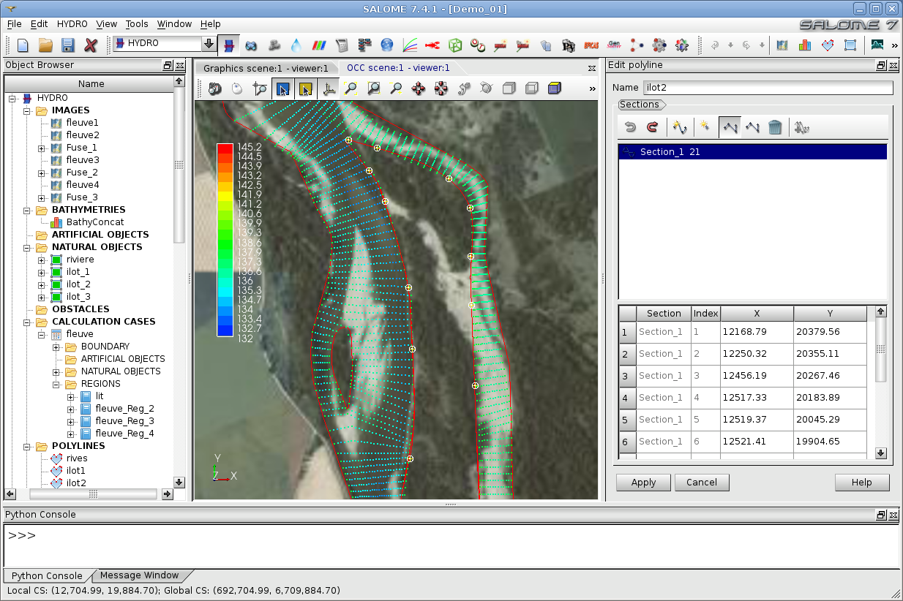
OpenTURNS and SALOME
SALOME
3 partners : EDF, CEA, Open Cascade
Integration platform for pre and post processing, and 2D/3D numerical simulation
Features : geometry, mesh, distributed computing
Visualization, data assimilation, uncertainty treatment
Licence : LGPL
Linux, Windows
www.salome-platform.org
A specific platform : SALOME-HYDRO

Slide 28
OpenTURNS and Salome
Telemac
Code_Aster
Saturne
Salome
Modules : Mesh, Paravis...
YACS
JobManager
OpenTURNS
Parametric
ADAO
GUI
GUI
GUI

Slide 29
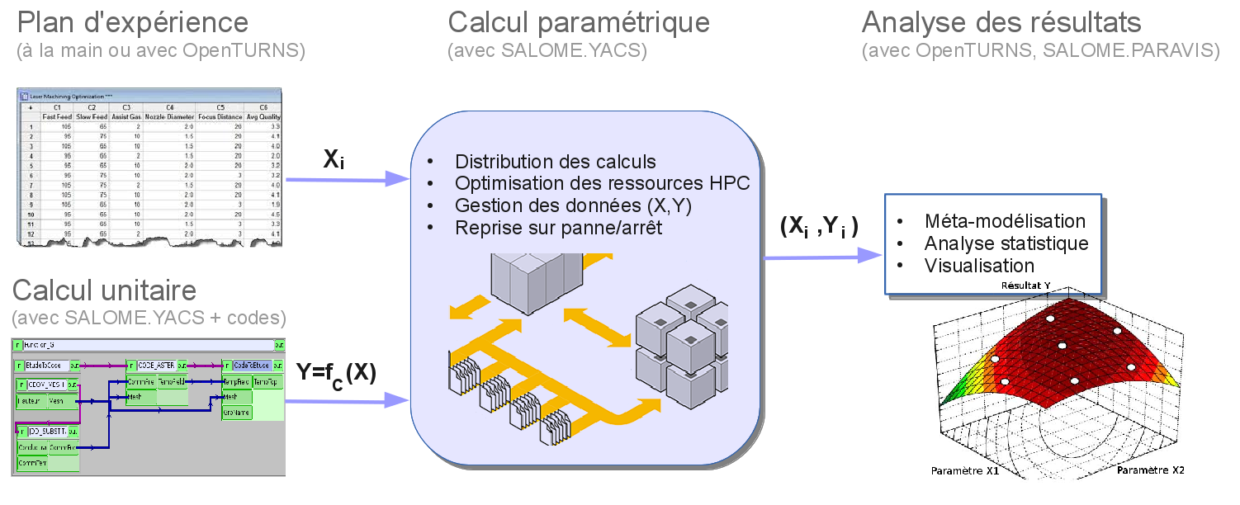
OpenTURNS : Utilisation de YACS

Slide 30

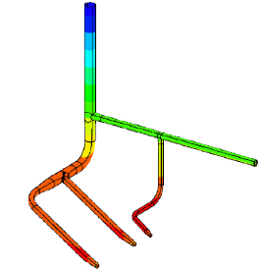
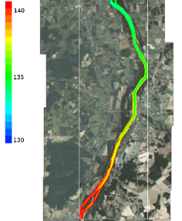
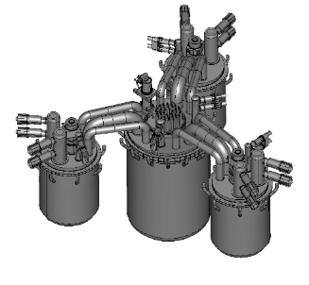
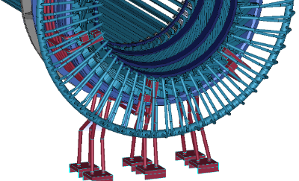
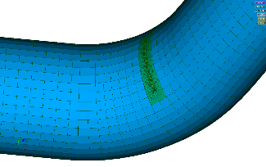
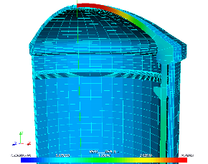
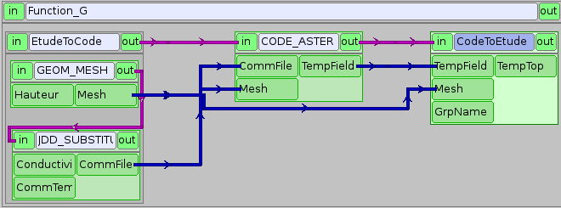
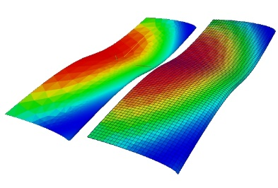
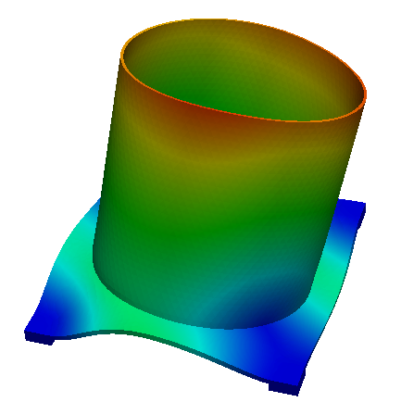
Contexte général de SALOME
Simulation numérique des systèmes physiques d’intérêt EDF
Mécanique (Code_Aster)
Thermohydraulique (Code_Saturne, Neptune_CFD)
Electromagnétisme (Code_CARMEL3D)
Neutronique (ANDROMEDE)
Hydraulique à surface libre (Telemac, Mascaret)
…
Besoins génériques de la simulation dans ce domaine
Modélisation 3D (CAO, maillages, visualisation)
Orchestration des calculs (composition, distribution)
Traitement de données complexes (champs, matrices)
= Plateforme SALOME

Slide 31
Design of experiments
What for ?
Model exploration
Central tendency : estimate mean, standard variation
Create meta-models, e.g. Polynomial chaos, Kriging, etc…
Deterministic DOEs :
central composite, factorial : axial, composite, box
Probabilistic DOEs :
Monte Carlo with given distribution
Bootstrap resampling
Importance sampling
Latin Hypercuve Sampling (LHS) and optimized LHS
Low discrepancy sequences : Sobol, Faure, Halton

Slide 32
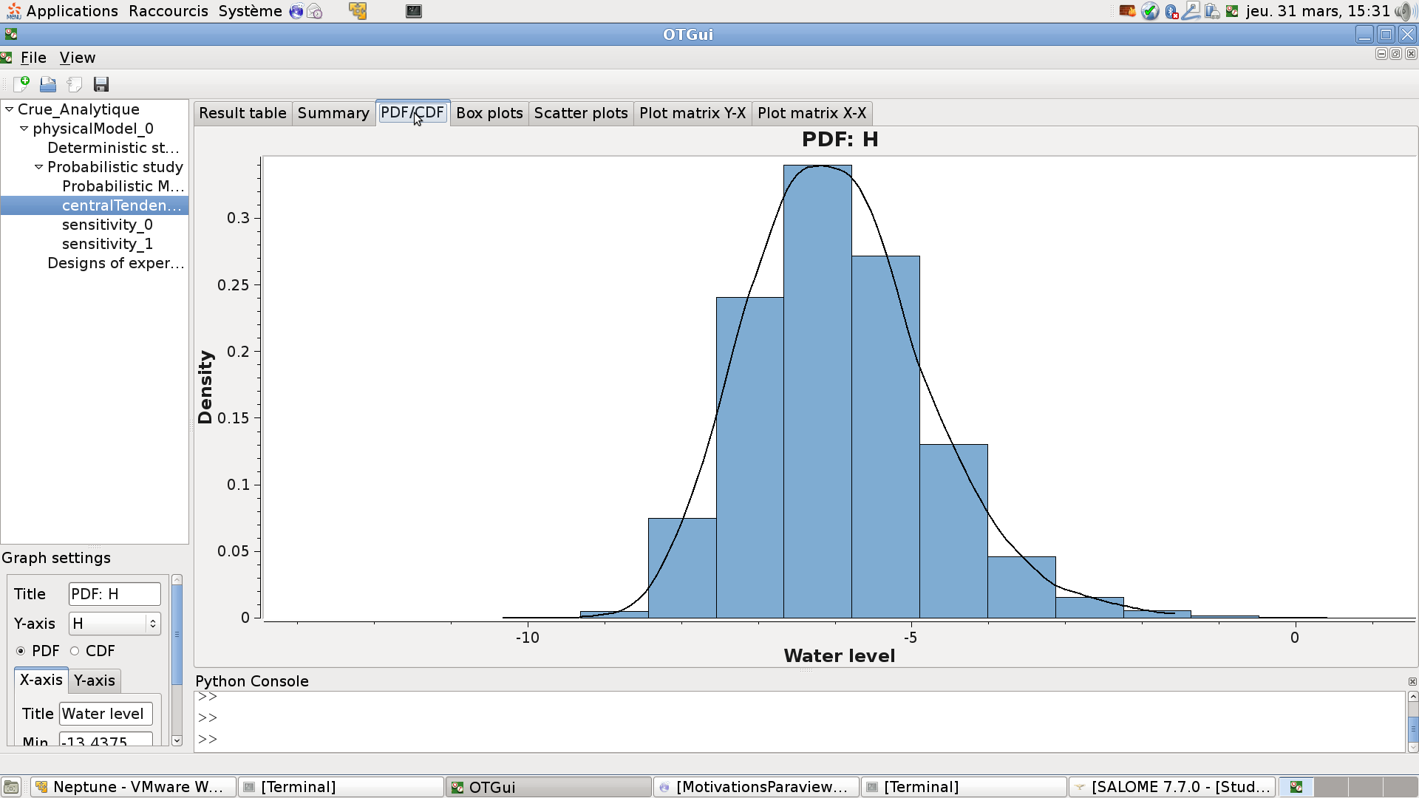
OpenTURNS GUI
Open TURNS – Trainings
Notes:
32

Slide 33
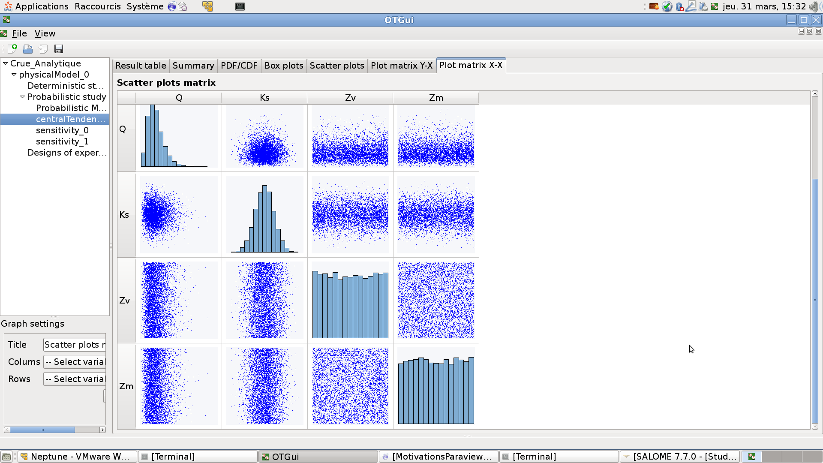

Slide 34
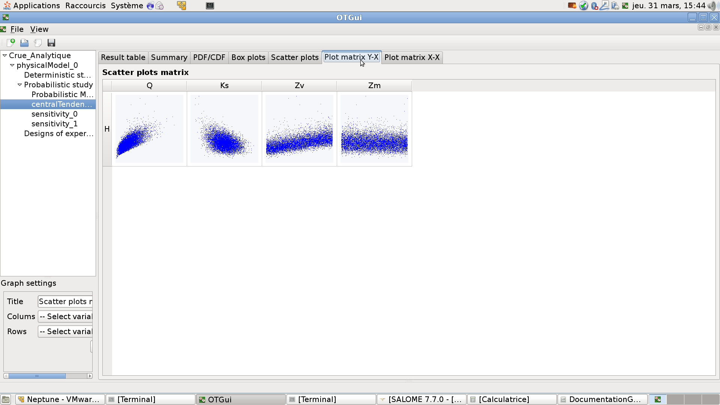

Slide 35
OpenTURNS Trainings
Open TURNS – Trainings
EDF
« Uncertainty Management : Open TURNS » : 3 days
next session : 5-7/09/2016, ITECH ref : 4889
« Uncertainty Management : Methodology » : 3 days
next session : 14-16/09/2016, ITECH ref : 4888
contact : Corine Tripet : 01 47 65 58 41
PRACE
1 annual session at « Maison de la Simulation (Saclay) », 3 days
Methodology + TP with OpenTURNS or Uranie
Phimeca
2 sessions each year
www.phimeca.com
Notes:
35

Slide 36
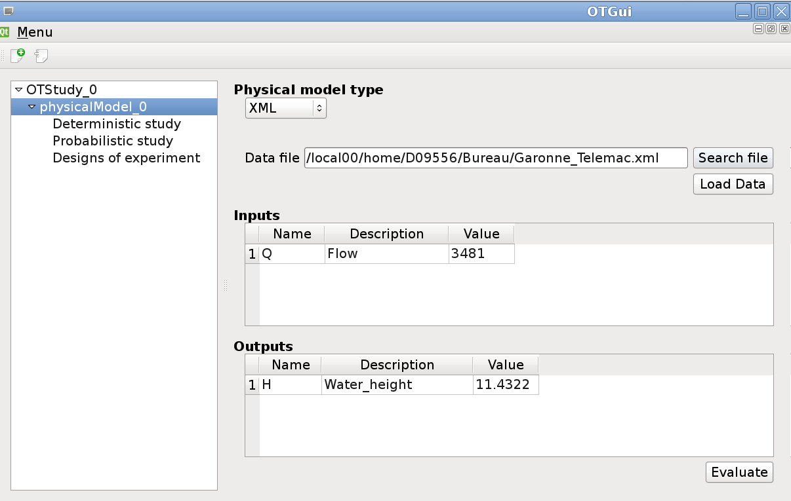
OpenTURNS Graphical User Interface

Slide 37
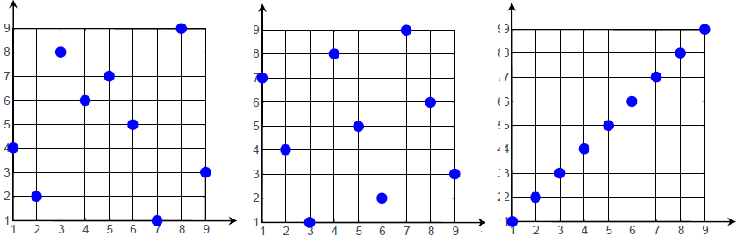
The LHS module
Goal : create Latin Hypercube Sampling (LHS) designs with good space filling properties
What for ?
Model exploration
Central tendency : estimate mean, standard variation
Create meta-models, e.g. Polynomial chaos, Kriging, etc…
In this module :
Types of designs : centered or randomized
Criteria : C2, mindist, φp
Algorithms : simulated annealing (or Monte-Carlo)
Limitation : independent copula

Slide 38
The LHS module
>>> import openturns as ot
>>> import otlhs
# Fix the uniform bounds (0 ,1)^2, size = 100
>>> Bounds = ot.Interval(2)
>>> lhs = otlhs.LHSDesign (bounds, 100)
# Fix criterion
>>> crit_sf = otlhs.SpaceFillingPhiP ()
# Defining a temperature profile (10,0.95,2000)
>>> temp_prof = otlhs.GeometricProfile ()
>>> algo = otlhs.SimulatedAnnealingLHS (lhs , temp_prof , crit_sf )
>>> result = algo.generate ()
# Retrieve optimal design
>>> design = result.getOptimalDesign()

